Slide 1
WHY
Business Challenges
Use Case Description
KPIs Impacted
Manual research across teams slows decision-making
Frequent reinvention of existing internal/external solutions
Lack of consistent, reliable competitive intelligence
Difficulty validating credibility of online information
Increasing explosion of AI‑generated tools, making comparison impossible
Risk of choosing suboptimal tools → impacts security, performance, cost
User enters an idea or problem statement (e.g., “Need a SAST tool for CI/CD”)
Multi-agent workflow runs autonomous discovery across the web and internal sources
Extracts comparable solutions, features, maturity, pricing indicators
Aggregates reviews (Product Hunt, GitHub, G2, blogs, sentiment)
Scores each option with transparent credibility metrics
Produces a ranked recommendation + Build vs Buy vs Partner guidance
70% faster research cycle time
20–35% increase in architect/analyst productivity
25–40% reduction in duplicated internal initiatives
Higher confidence through evidence‑backed decision-making
Research‑Scout++:
Autonomous Innovation Intelligence System
Business Impact
Reduces research from hours/days → minutes
Prevents redundant development across teams
Surfaces hidden competitors and emerging AI tools
Delivers consistent and credible intelligence
Enables faster, more traceable strategic decisions
HOW
WHO
Functional Solution
Technical Solution
Stakeholders
Multi‑agent system orchestrating discovery, evaluation, and scoring
Automatic extraction of structured data from URLs
Review aggregation from Product Hunt, GitHub, G2, blogs
Credibility scoring using recency, trust, adoption, technical depth
Generates ranked solution list and decision-ready reports
Azure Functions (Python) for search, extraction, scoring tools
Bing Web Search API for grounded external discovery
Product Hunt + GitHub APIs for review intelligence
Optional Microsoft Graph Connectors for internal enterprise search
Responsible AI: Content Safety, Prompt Shields, audit logs
Outputs: JSON, Markdown, PDF, Teams integration
Product Managers & Innovation Leaders
Enterprise Architects & Engineering Teams
Consulting & Pre‑Sales Teams
Market Intelligence & Strategy Teams
Risk & Compliance (auditability, traceability)

Slide 2
Use Case Scope in the Business Process
Detail the business process and highlight the Use Case in the process
Use Case scope
L1
Streamline Recruiting
L2 4 sub-processes
Campaign Planning
Campaign Design
Campaign Execution & Follow Up
Campaign Supervision
PROCESSES
L3 13 macro tasks
Performance Analysis & Territory wise Brand Analysis
Select Territories
Create Collaterals
Content Generation
Content Assembly
Quality & Compliance
Distribute Campaign
Engage Sales Teams
Conversion Tracking
Campaign Adjustments
Content Request
Bottleneck resolution
Approval
L4 36 micro tasks
AGENT
AGENT
AGENT
GENAI
AGENT
AGENT
AGENT
AGENT
AGENT
Hiring Intake Agent
JD Skill Extraction
Job Posting
Resume Ingestion
Real-Time Content Adapter
Compliance Checker
Sales Call Manager
ROI Optimizer
Approval Manager
DATA & AI
RAG
Data platform, data governance, data management
Transforming the apps landscape, integrating with apps, infrastructures & data landscapes:
DIGITAL
Third Party
Sales Info
Handheld & Interactive Systems
Brand Master
CRM
Campaign Master
SFA System
Other Tools
Human
RPA/script
AI/ML
Gen AI
Agentic AI
Outcomes
(if at scale)
+ 40-80%
+ 20-35%
>90+%
+ 50-70%
Faster Campaign Cycle Time
More time on Strategy
Automated QA & Compliance Checks
Productivity (FTE Hours Saved)

Slide 3




Functional Solution + AI-Human Chemistry
Provide a Diagram with the functional components of the solution and the points where the Agent(s) will take decisions or will handle it to humans
Request missing/ conflicting information
Service Agreement
Interaction (customer, third- party or internal teams)
Gather approval if needed
Agent1
Text to Insight
Agent interacting only with systems not with humans
Inbound Channels
Contract Created
Customer places an order
Email
Validate Information
Create contract
Update pricing & Block
Sales raises request to modify agreement
ServiceNow
Language Translation
Communicate to customer/Sales & AR team
Update Contract
Rebates Payout
Agent2
Create/upload Settlement
Inbound Channels
Credit Note created
Sales request for Settlement of Agreement
ServiceNow
Gather CN approval
(get approval in case out of def. threshold)
Create Credit Note
Capgemini request to validated Payout date
Communicate to customer/Sales and AR team

Slide 4
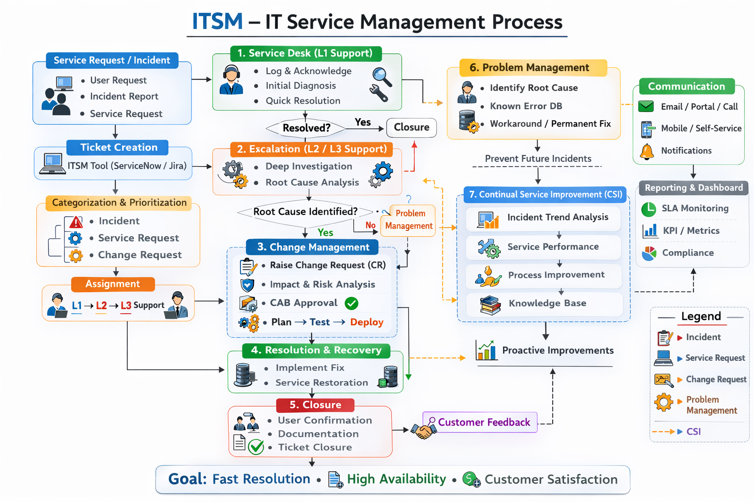
Technical Solution
Provide a Diagram with the Technical components of the solution and the key Microsoft components that will be used
technologies
GitHub Copilot
Microsoft Foundry
Microsoft Fabric
M365 Copilot
Copilot Studio
D365 Copilot

Slide 5
Business Case Proposal – Medical AI Assistant
WHY
BUSINESS CASE
KPIs Impacted
Current Costs
Current Income
70% faster research cycle time
20–35% increase in analyst & architect productivity
25–40% reduction in duplicated internal initiatives
Higher confidence & traceability in decision‑making
High operational workload due to extensive documentation and administrative tasks
Strong dependency on support staff (₹15–20 Lakhs/year)
Slow patient processing leading to delays and reduced efficiency
Revenue currently impacted by slow turnaround and inefficiencies
Estimated annual revenue: ₹1–2 Crores
New Costs
New Income
Business Impact
Model development & fine‑tuning: ₹8–10 Lakhs
Azure infrastructure & deployment: ₹5–7 Lakhs/year
Maintenance & updates: ₹3–5 Lakhs/year
Total New Cost (Year 1): ₹15–20 Lakhs
Increased patient handling capacity
Faster consultations and improved service quality
Higher retention due to better experience
Expected annual revenue increase: +10–20% (₹20–40 Lakhs/year)
Eliminates manual research effort across product, engineering & strategy teams
Prevents rebuilding solutions that already exist internally or externally
Improves competitive intelligence using autonomous multi‑agent discovery
Enhances decision‑making with evidence‑backed insights
Reduces time-to-decision for Build vs Buy vs Partner
Ensures reliable, consistent, and credible information for leadership reviews
BREAK EVEN:
Time to recover implementation cost: 12–18 months, driven by
Reduced admin staffing effort
Faster clinical workflows
BREAK EVEN: Time to recover via additional revenue: 8–12 months, driven by
Higher throughput
Improved service quality
BREAK EVEN: Return on investment achieved within 8–12 months through: +10–20% increase in patient handling capacity
Reduced operating costs from automation
Improved service quality leading to higher retention
Lower documentation burden for clinicians.

